Slide 1

Arts & Culture: Tools of Peace in Rwanda
Dr Allan T. Moore, Professor Gayle McPherson & Dr Sophie Mamattah
University of the West of Scotland

Slide 2
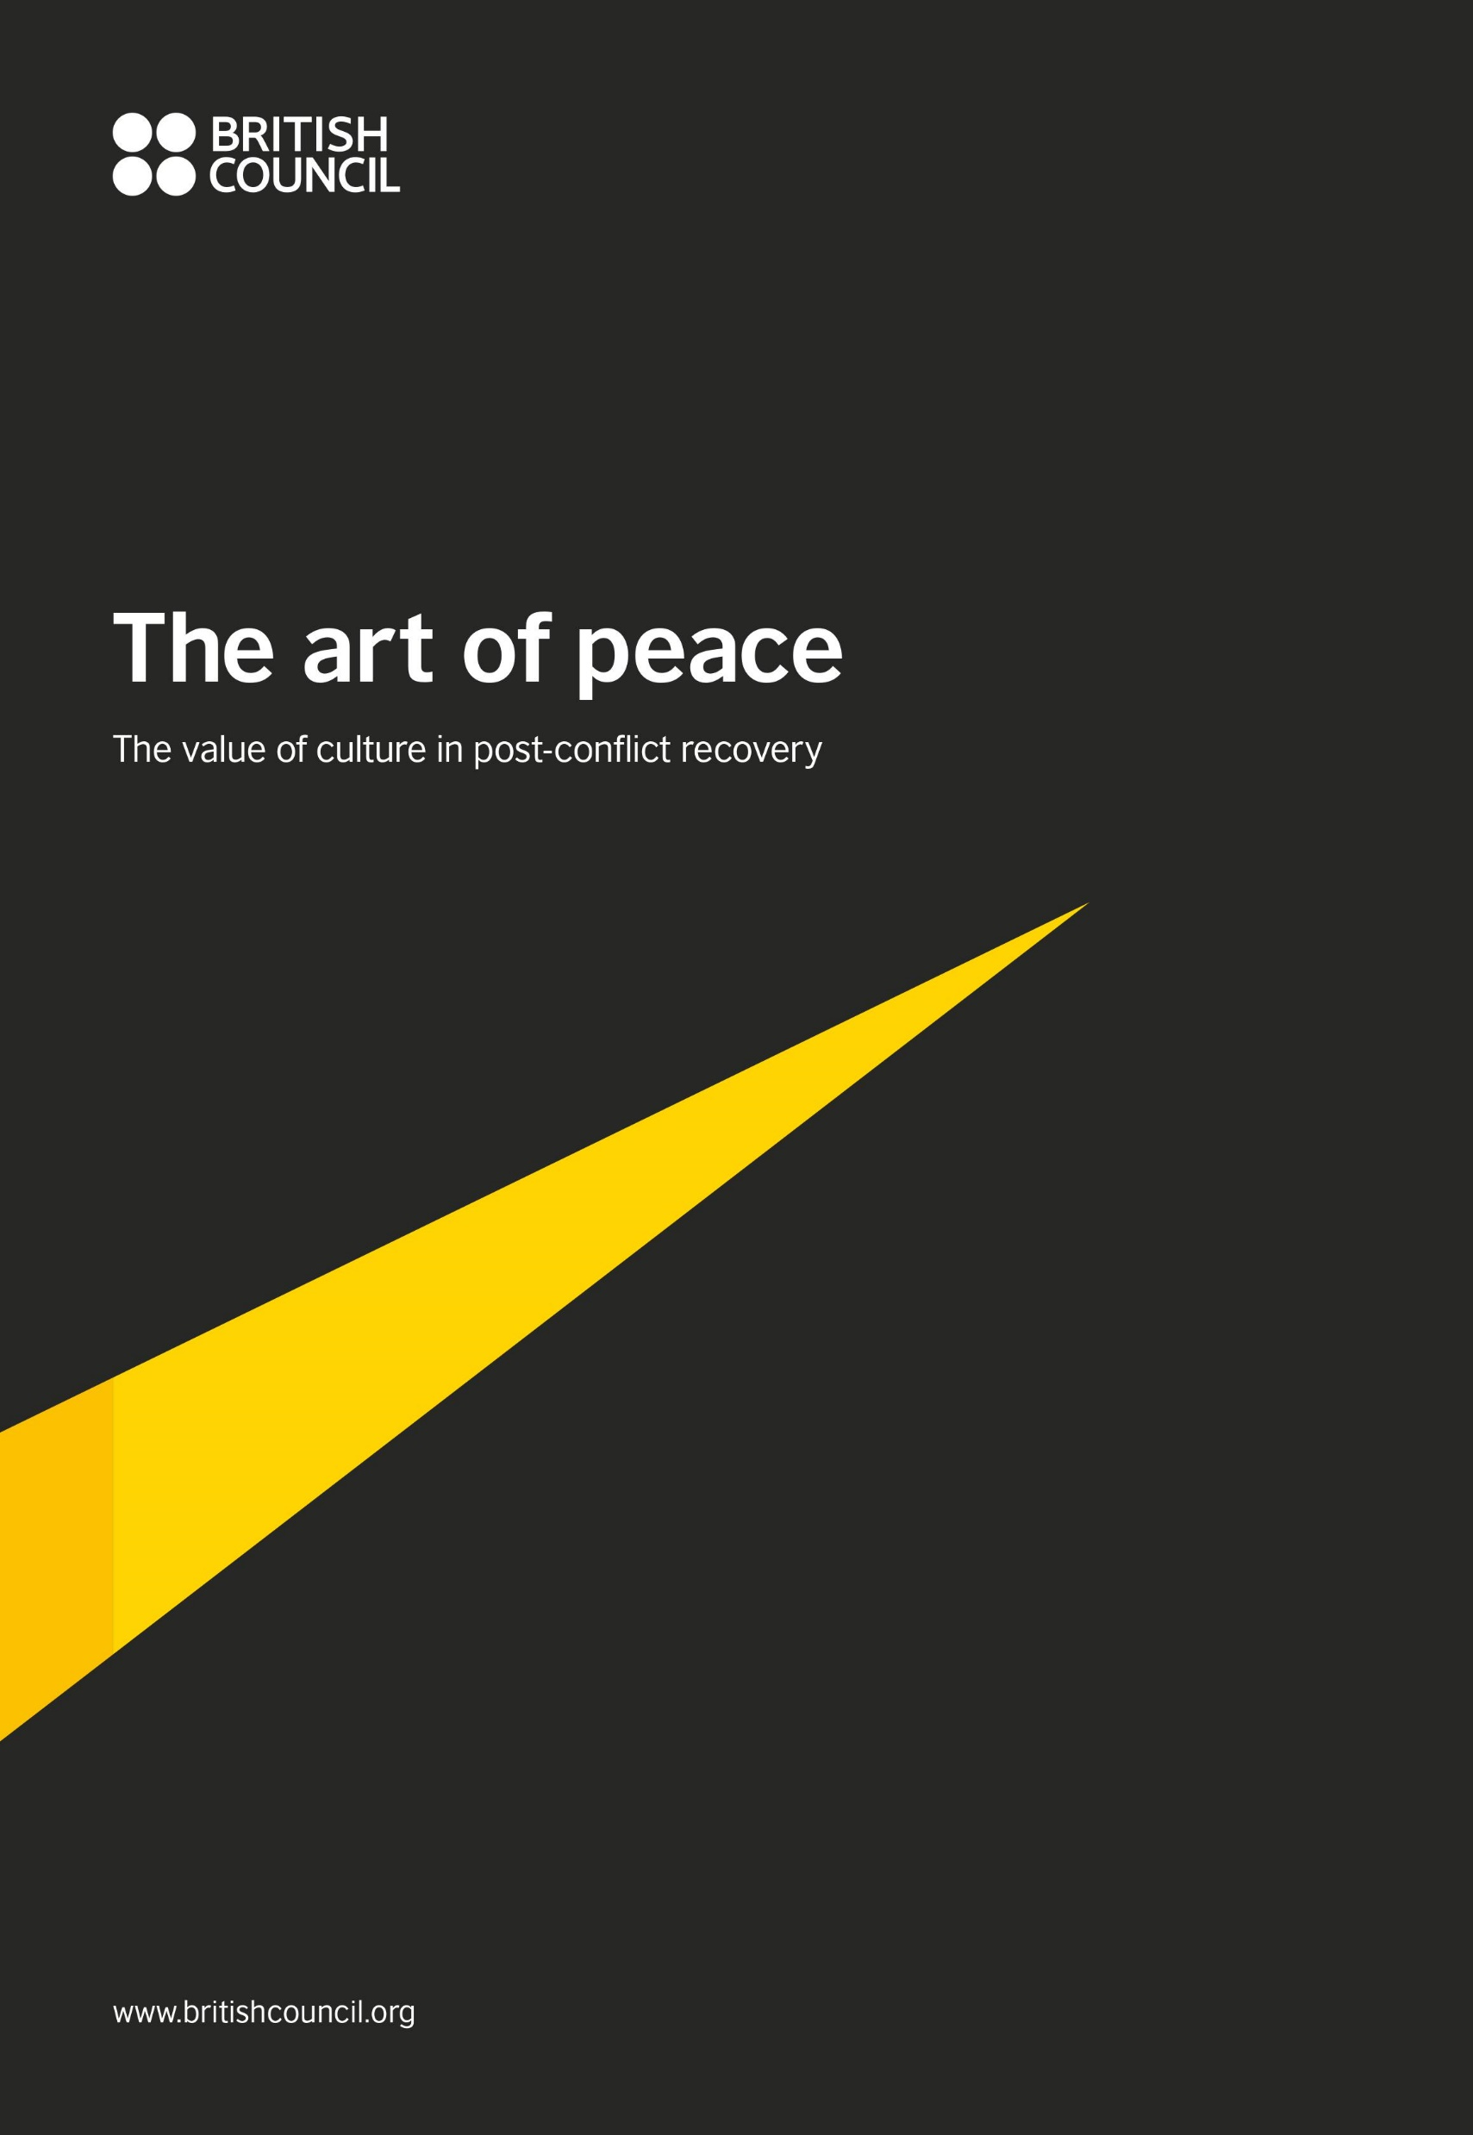
Some initial observations
Background to the research (Personal and Team)
British Council Report – The Art of Peace (Alison Baily, 2019)
UWS Report – A Review of the Contribution of Arts & Culture to Global Security & Stability (McPherson, Mamattah, Moore, Cifuentes & Moualla, 2018)

Slide 3
In short…
We argue that in the Rwandan context, there is real importance and significance to ongoing peace and security linked with both national politically driven and local homegrown culture and arts based initiatives and activities.

Slide 4
In the current paper…
Analying specific examples:
  Rwanda National Art Gallery (Both former in Nyanza and current in Kanombe – former Presidential Palace Museum)
  Ndi Umunyarwanda
  Itorero
  Ubumuntu Festival at Kigali Genocide Memorial
  Never Again Rwanda
  Kwibuka

Slide 5

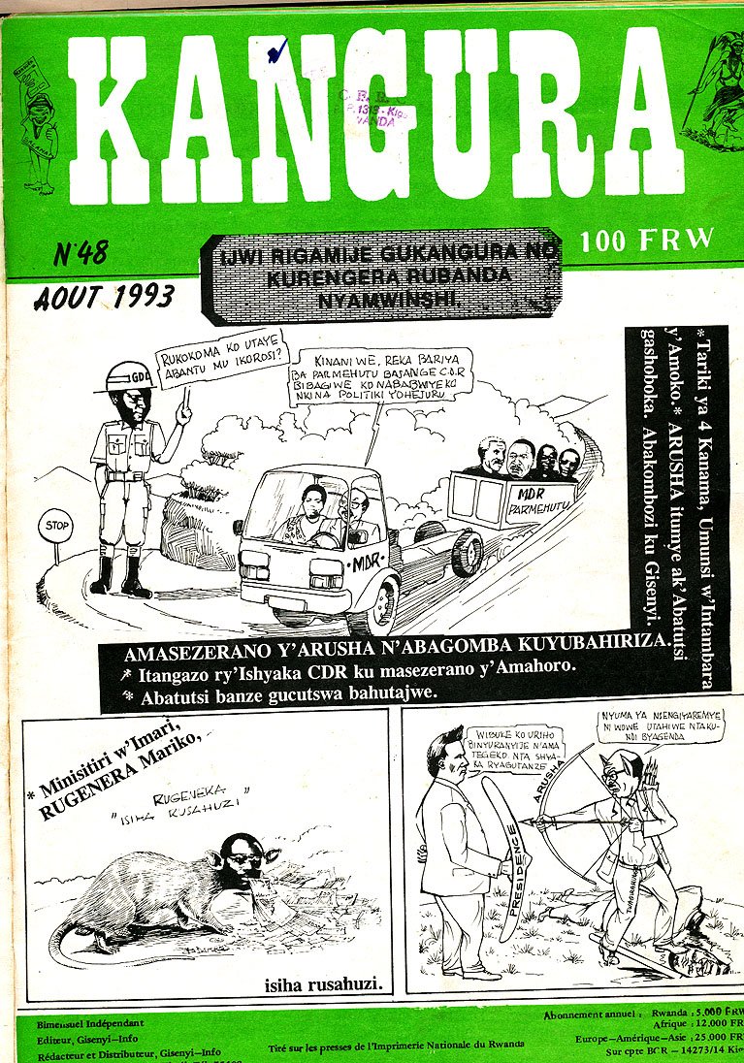

We will look at two of these examples in a moment, but first…
Our starting point is not that all arts and culture activities help to promote peace and security:
Art and culture are not in and of themselves intrinsically peaceful.
At times arts and culture have been used to undermine security and stability and pursue violent agendas.

Slide 6
And so the point is:
Care must be taken when implementing sub-strategies of arts and culture as part of larger peace and security strategies
There is now a growing body of literature on the role of the arts and culture in post-conflict settings, with a number of common themes emerging:
  The therapeutic benefits of art (helping with trauma)
  Art as a means through which reconciliation/peace and civil society building processes can be negotiated and developed
  Arts and Culture-based interventions more likely to be successful when they are embedded in local cultural norms and expectations & include those they are intended to reach in their design and advancement

Slide 7
Importantly to Africa (in this case Rwanda)…
African psychology cannot be ignored and must be taken into account:
As the expression of all that constitutes the every day way of life of a people, culture defines and gives meaning to everything experienced by the living. Accordingly, culture defines and gives meaning to the notion of human development. (Nobles, 1986: 106)
It is in the reclamation of our culture and ancient African thought and the creative reconstruction of them as African psychology, that Black people can regain control over the interpretation of our reality and the process of our human development. (Nobles, 1986: 106)
In other words – African countries need African solutions to targeted cultural development initiatives and NOT replication of Western models

Slide 8
Going back to those examples…
Itorero
  Historically – cultural school with focus on social relations, sport, national defence, music and dance.
  Became marginalised through colonial and post-colonial period.
  Relaunched in 2007 “civic education institution which aims mainly at teaching all Rwandese to keep their culture through its different values such as national unity, social solidarity, patriotism, integrity, bravery, tolerance, the dos and don’ts of the society, etc.” (National Itorero Commission)

Slide 9
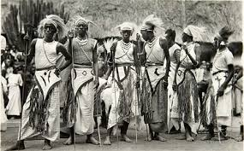
Going back to those examples…
Itorero
  Maintaining the Itorero title is important as it contains the imagery of the Intore ‘whose spectacular war dances have survived as a relic of the old Itorero tradition in popular culture to the present day’ (Dahlmanns, 2015:114)

Slide 10
Going back to those examples…
Itorero
  An interesting dichotomy that the culture and art form traditional Itorero is fundamentally linked to contains the image of conflict, whilst the modern Itorero is designed to help build and maintain peace.
  The development of culture is crucial here – past criticisms of Itorero that it is based upon former Tutsi culture, however Dahlmanns explains that the culture, music and dance have developed to become a nationally shared cultural heritage.

Slide 11
Going back to those examples…
Itorero
  Ibyivugo poetry is a fundamental part of the National Itorero Day in emphasising the importance of national unity and trivialising the importance of ethnic identity.
    Can you acquire free shopping because you are Tutsi? Can you travel to Kampala without paying because you are Hutu? Will being Twa enable you to score goals on the football pitch? If not, there is no need to praise them…
    “Most important for us is tolerance, to be peaceful as Rwandese people, let us be tolerant, Rwandese people born in Rwanda, let us reconstruct our country as Rwandese people!” (Translation)

Slide 12
Going back to those examples…
Ubumuntu (Humanity)
  Arts Festival held in Kigali annually since 2015, founded by Hope Azeda at the amphitheatre of Kigali Genocide Memorial.
  Aims are explicitly linked to building and maintaining peace, with three of the six main aims being:
    To prevent Genocide;
    To promote peace building and healing from violence; and;
    To equip the festival attendees with tools to enable them to be agents of change.
  With these aims being addressed through public interaction with the Arts

Slide 13
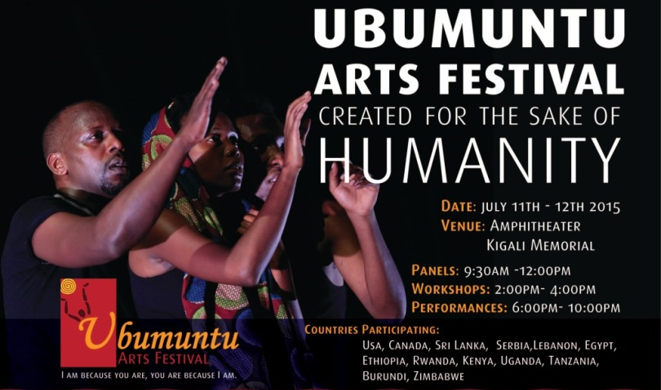
Going back to those examples…

Slide 14
Going back to those examples…
Ubumuntu
  It is clear that attending the Ubumuntu festival is not intended to be a passive experience for the audience where they simply enjoy the show and then move on, rather it is anticipated that they will effectively become ambassadors for peace and societal change through their experiences at the festival.
  One participant, Emma Muhoza, told me, “When language fails us, art expresses what we feel.” Empathy spearheads social change. The reciprocity of emotions spring from audience to performer, observer to participant. We aim to curate the festival to prompt everyone to act in kindness, regardless of background. Every year unlocks a fresh set of exercises to make new strides in civic engagement. We try to create a safe space to learn about perpetrators and victims alike, in the quest for a common ground. (Azeda, 2018)

Slide 15
Going back to those examples…
Ubumuntu
  Summarising then: Different types of artistry, that whether designed that way, or simply through the reality of the contexts in question convey concepts including:
    social change & transformation
    civic engagement & governance
    peace, justice & security
  All of these are key themes that the overall Ubumuntu mission is playing a part in trying to improve and achieve, in Rwanda, the wider region, and Globally.

Slide 16
Conclusions
It is clear that several of the international criticisms of Rwandan approaches to cultural integration and harmonisation are fundamentally flawed, without taking into account specific African and Rwandan context and psychology.
Many of these criticisms might have theoretical / academic validity in a general Westernised context but lose substantial validity when attempting to transpose to either an African ( post-conflict in general) or Rwandan (specifically) post-genocide context.
The Arts and culture had been for decades in Rwanda prior to 1994 used as part of negative, destructive propaganda to dehumanise. The Arts and culture post-1994 have gradually developing to be positive, transformational, and to emphasise cohesiveness and humanity.

Slide 17
Conclusions
Importantly, the substantial growth of the Arts in Rwanda has been shown to rebut further international criticism on the stifling of critical thinking in the country. The Arts explicitly encourage individual expression and substantial critical thought, and the growing central positioning of the Arts through the recently opened National Art Gallery at the former Presidential Palace Museum, and as part of many Government, NGO, CSO, and indeed individual economic activities, shows that real opportunities to develop such critical thinking skills are encouraged.
Many other countries in the Great Lakes Region and beyond would be wise to look to the examples of the development of the Arts and Culture in Rwanda. They may not be able to find precise models to use within their own culture and conflicts, however what does have a degree of certainty is that for the positive cultural transformation of the citizenry of any country to be truly successful, there should be a considered analysis of the Arts and culture that has existed historically as embedded within the society in question, and how this can be harnessed in a positive way that is inclusive, fosters cohesiveness, and identifies common ground for all.

Slide 18
Thank you!
Questions / Comments
References - All in full paper and available on request

